Slide 1
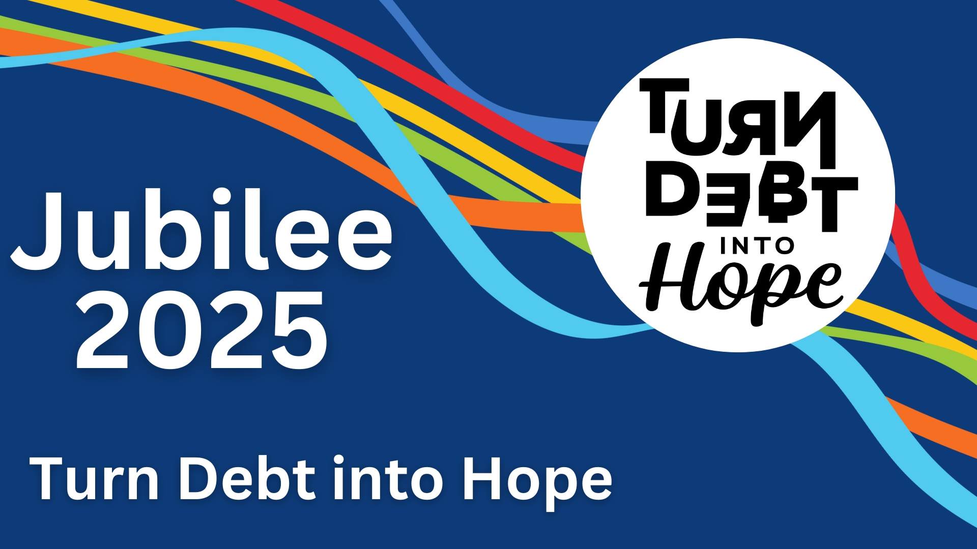

Slide 2
3.3 billion people (40% of the world’s population) are facing a debt crisis.

Slide 3
Call on creditors and world leaders for:
Debt cancellation for unjust and unsustainable debts.
Global financial reform to prevent future crises.
A debt resolution framework within the United Nations that is transparent, binding and fair.

Slide 4
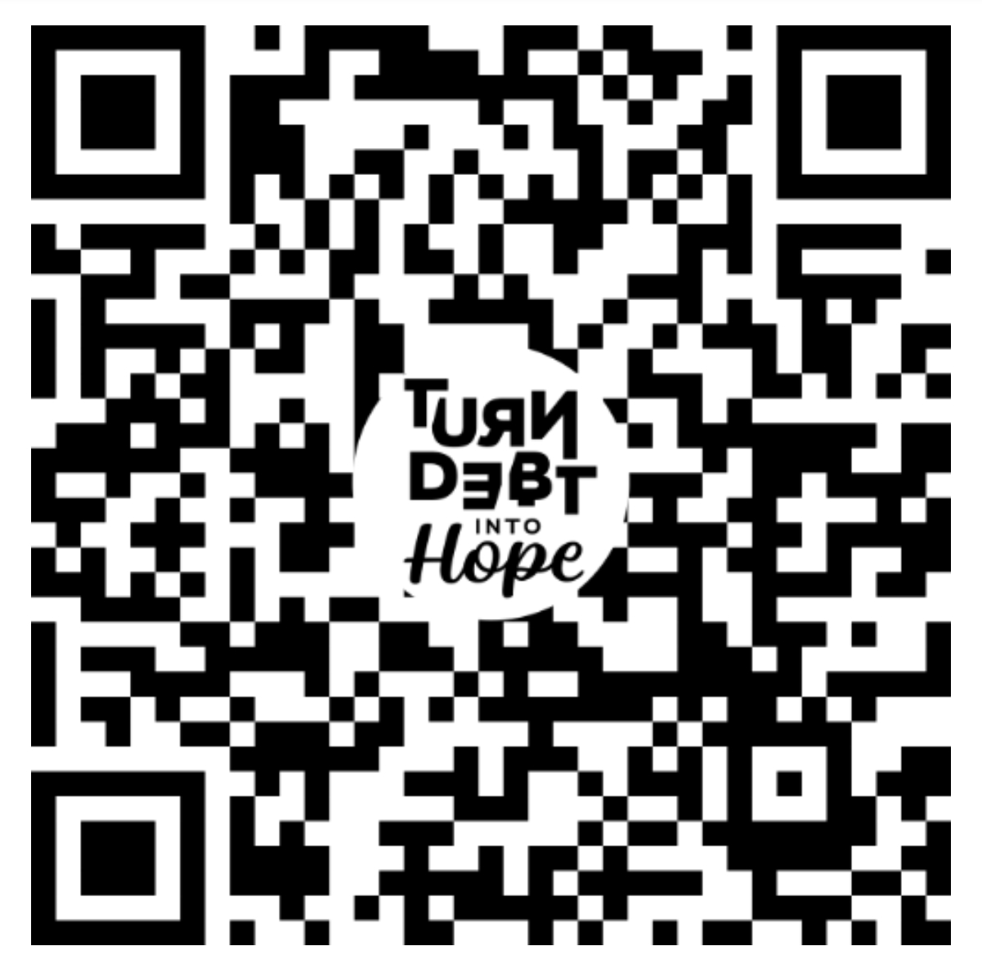

Jubilee 2025
Sign the Petition!

Slide 5
Help us reach 100,000 signatures in Canada!
Sign the petition.
Share the petition link with friends, family, colleagues.
Bring a paper petition to your next community event.
Register for Jubilee 2025 events to learn more and support the campaign in Canada.

Slide 6
